Slide 1

Breaking Down Barriers

Slide 2
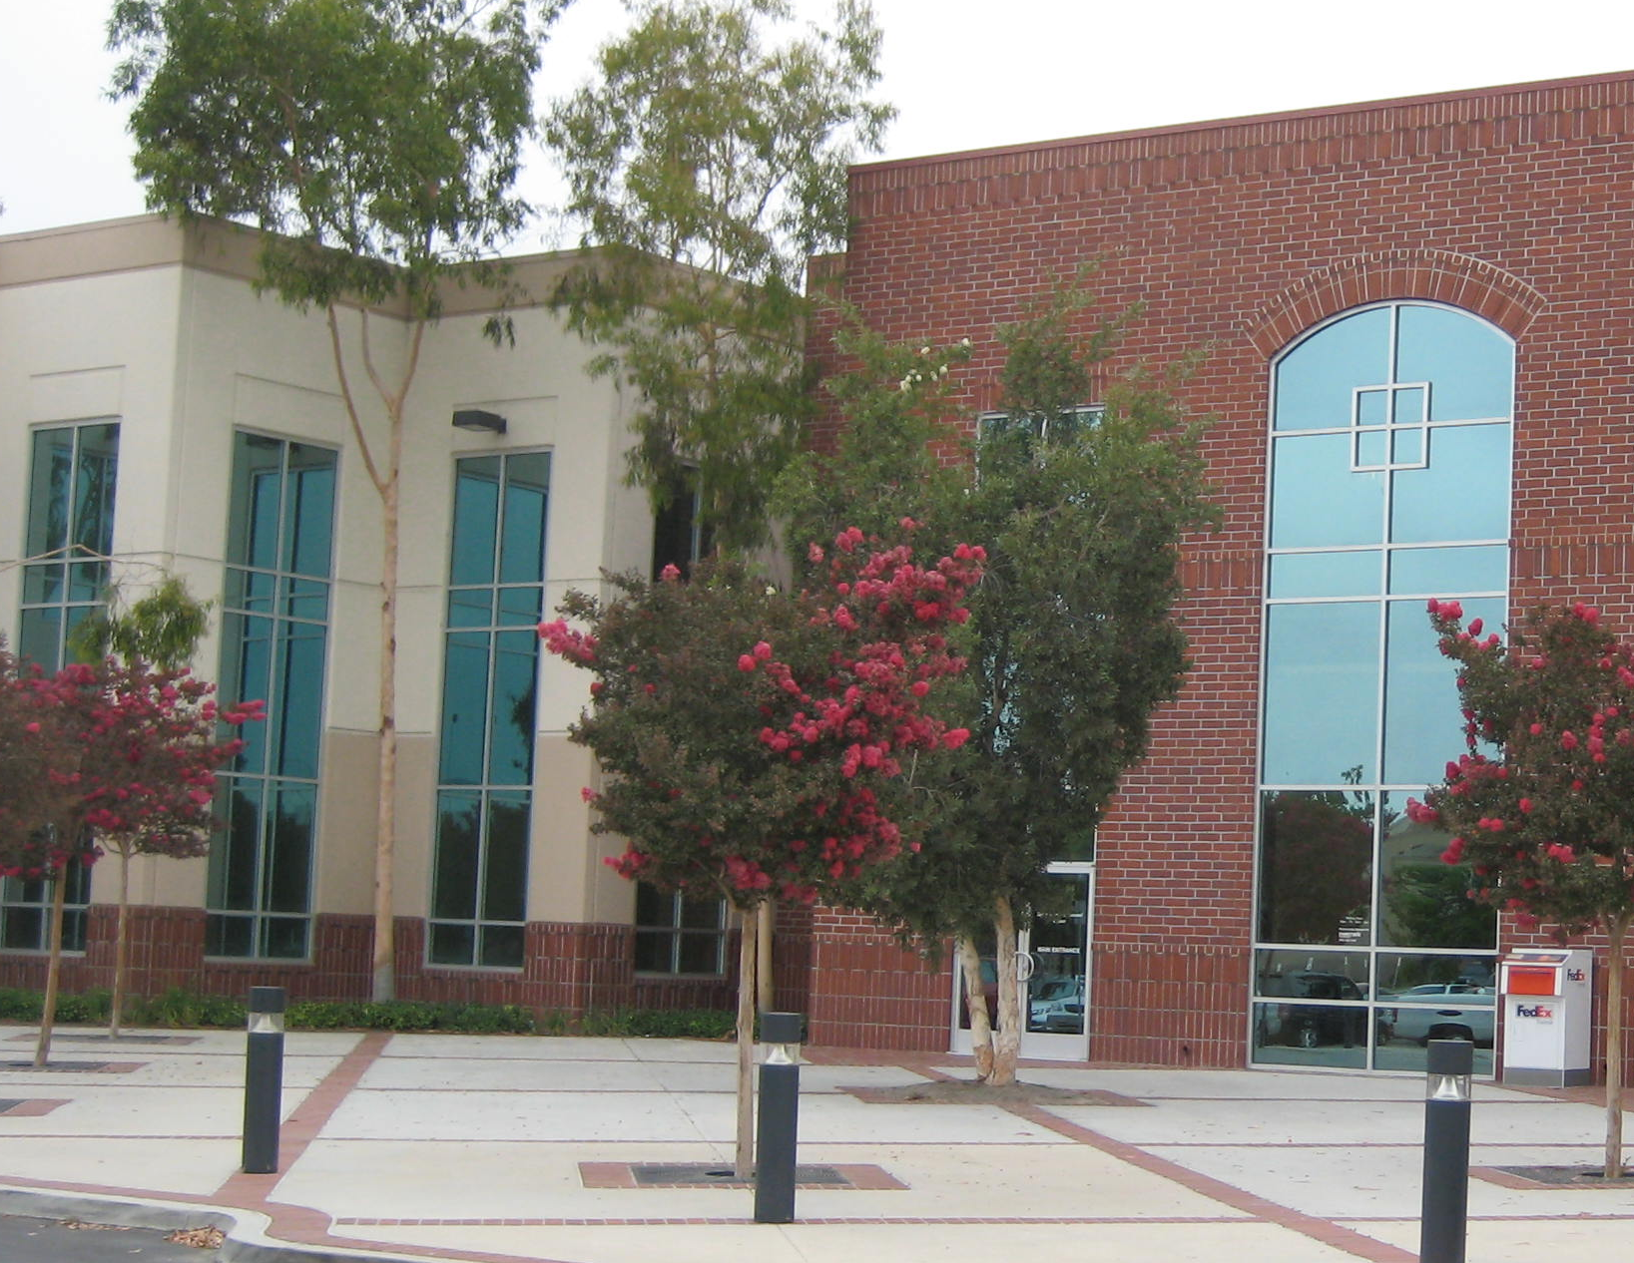


The Issue
Lack of Enrollment at First Contact

Slide 3

Understanding What’s At Stake…

Slide 4

You Spoke…We Listened

Slide 5

Required Workshops

Slide 6

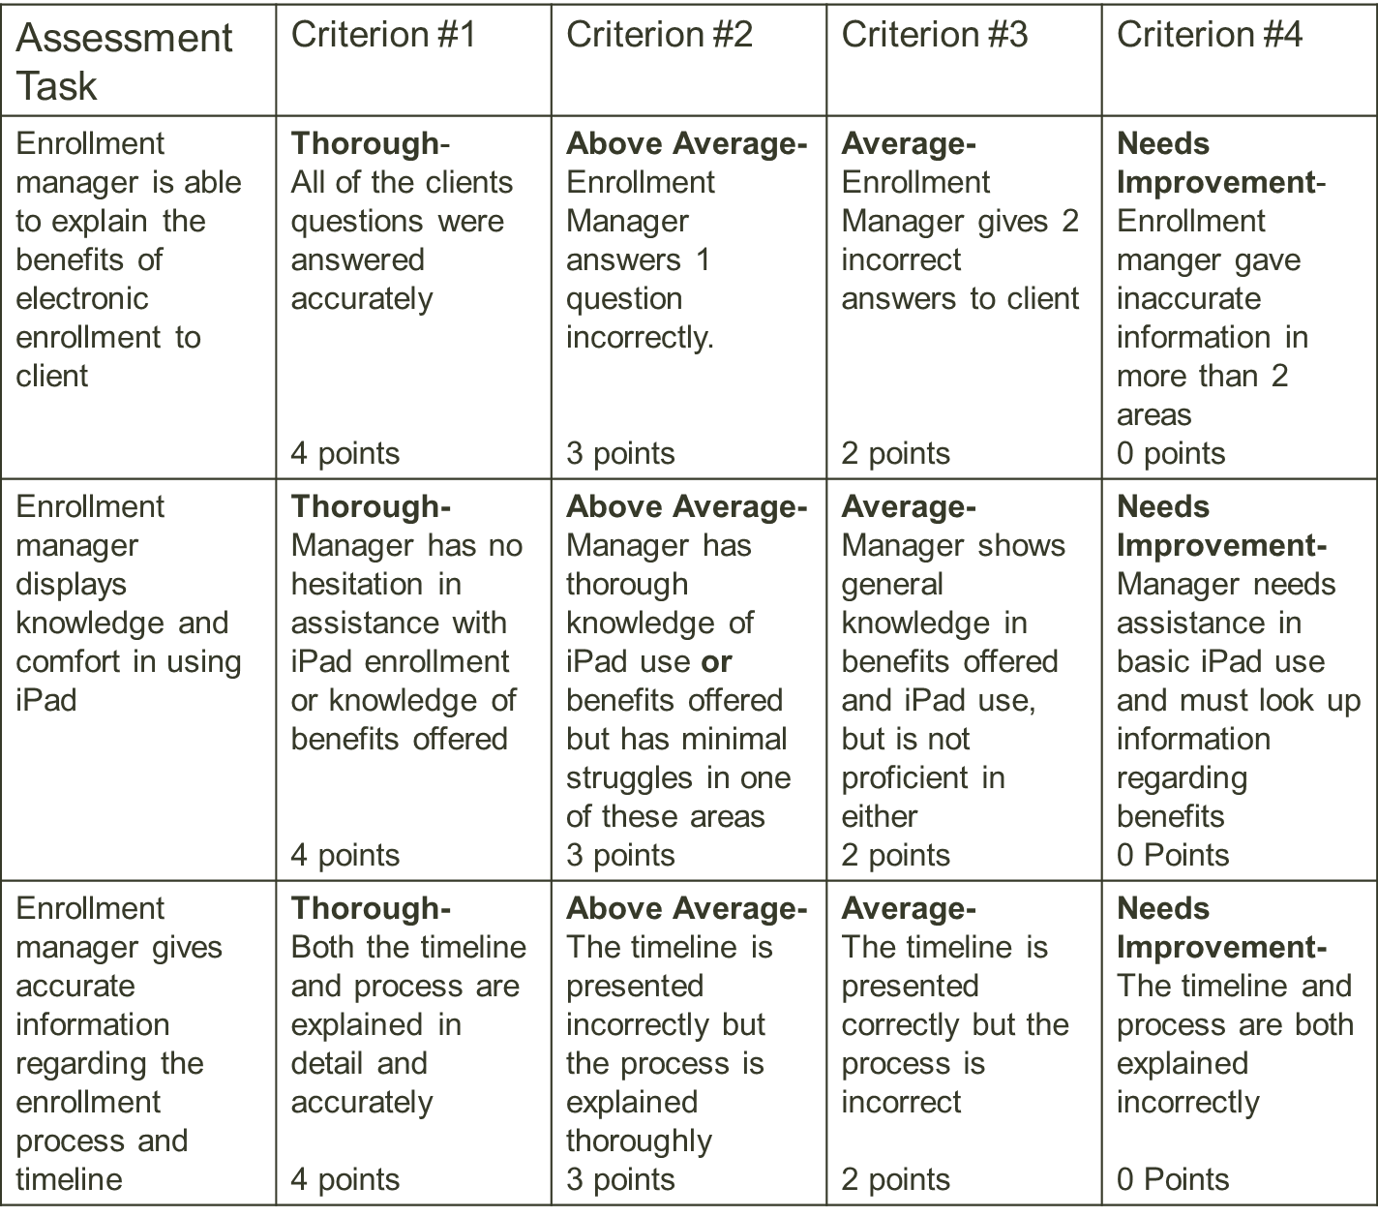
Assessment of Performance

